Slide 1
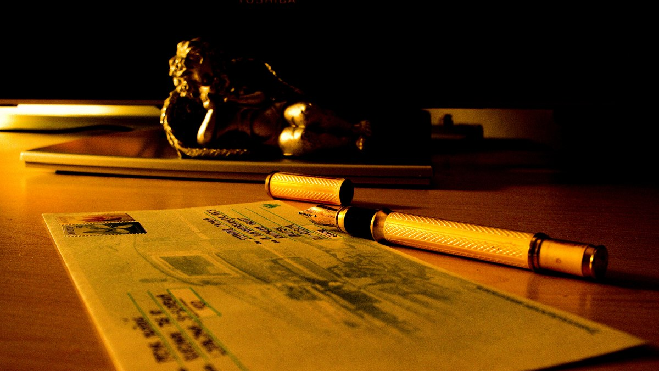
Creative Writing Department
Colonial Middle School
This Photo by Unknown Author is licensed under CC BY-SA

Slide 2
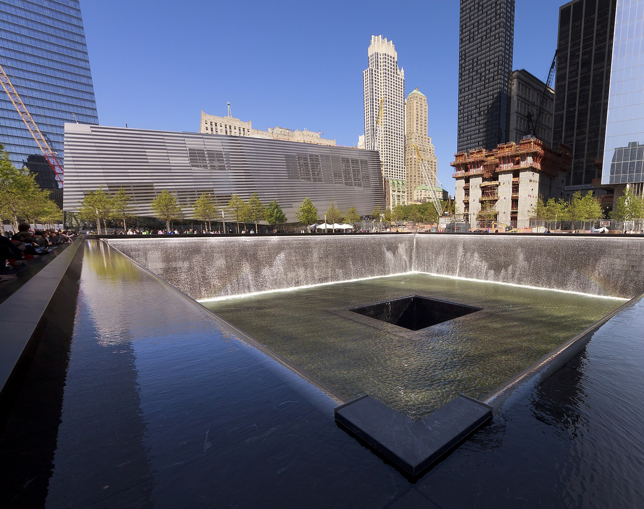
Tributes to 9/11
CAPA Creative Writing
7th Grade
This Photo by Unknown Author is licensed under CC BY-SA

Slide 3
Duncan B.
We tumble and fall, but stand, through it all
We crumble and rebuild, and try to stand tall
We push through the pain, for those who died
And encourage each other to put it all behind
We honor those we lost, by visiting their grave
And say "Whoever did this, shall get punished someday"
We mourn over our family whom we have lost
Then we honor them by moving on and adjust
And help rebuild for the ones who got tossed
It's been months, I'm doing fine, putting it behind
We miss them none the less, and move on

Slide 4
Heather C.
We Come Together
America comes and works together; we rebuild together what was destroyed
We fix what was destroyed by people who're confused
We watch what others do to our country everyday
We sat through dust, destruction, and waste for days
Our people watched close family not survive during this
We come together to rebuild what happened on 9/11
They just don't know...they don't know, about Americans
We live in a country where some don't care
But those don't want us to succeed, we fight
We thank those for who truly cares what happens
Because those are the people who rebuild the destruction

Slide 5

Camryn R.
Nine eleven was an attack on the twin towers.
In this attack 2,977 people were killed that day.
Non-aware people came into that building on September 11.
Even 25,000 people were injured in this terrorist attack.
Eager people began going to church way more often.
Lads and ladies lost lots of their family members.
Everyone was afraid of if another would take place.
Vexed citizens moved forward on from this tragic incident.
Even though the twin towers are no longer here today,
No one has ever forgotten about September 11, 2001.
2001 was a historical year everyone should remember.

Slide 6
Russel S.
We are a Huge Family
On September eleven everybody in New York was struck
We remember the people who were lost that day
We help everyone to comfort and remember their loss
We remember so we realize this could happen anytime
Thousands died but we don't cry, together we rebuild
It was scary, but we still have many family
We should be happy for those who were safe
Those bad people want to see us people suffer
But this is our country, we love each other
Not many people remember but they will, someday soon
We will remember this day to help one another

Slide 7
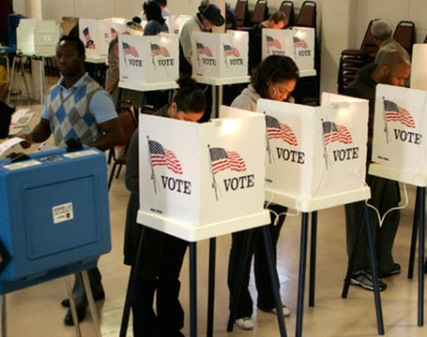
Voting Rights
On November 3, Our poems were displayed. The students wanted to be the voice of the issues voters should understand before casting their vote.
8TH Grade CAPA

Slide 8
Global Warming by
Warren S.
Cough, Cough
The Earth's increasing fever is deadly.
Killing whole species, destroying whole habitats.
The Ocean is Lemonade glaciers are ice.
Melting Glaciers are Watering down Oceans.
Tick...Tock...Tick...Tock,
Every second the Earth is heating up 2 degrees.
In less than 20 years all the ice is expected to melt in the Arctic.
The last ten years have been the hottest ever on this Godforsaken Earth.
It's time to pay up,
The debt you owe is immense.
34.6 Trillion, more than National Debt
It's sad,
That it's facts.
Your beliefs are yours,
That I respect.
But ignoring facts you are oblivious to,
I cannot respect.

Slide 10
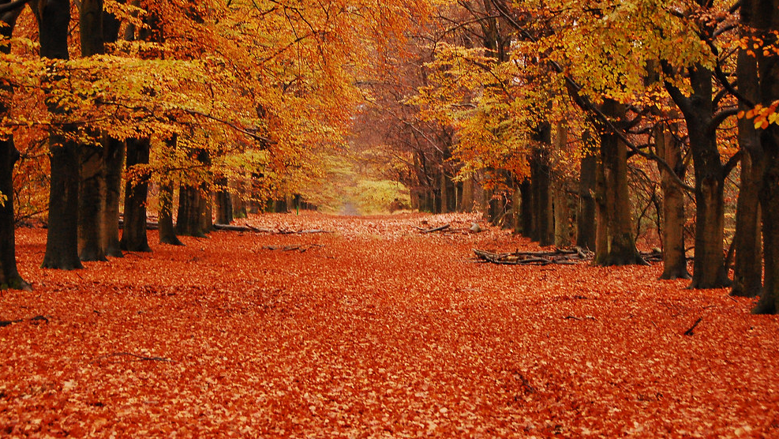
Ode to Nature
Fall Writings: 6th Grade CAPA
This Photo by Unknown Author is licensed under CC BY-SA

Slide 11
The Fall by Darlene P.
With leaves turning golden, red, and orange
Forests being turned into a beauty
By the colorful colors of the leaves
What a beautiful forest just like,
A bag of starburst spilled onto a table
Imagine flying over a lively forest
With leaves colored in golden, red, and orange
Standing out saying welcome to, fall.
Loud crunching fills the forest as you are walking .
The sound of crunching leaves goes away and you wonder.
you wonder as the sound of the crunching leaves goes away.
A pile of leaves are in front of you, you jump on them, crunching is the only thing you hear.
The only thing you hear is crunching, as you jumped on the pile of leaves.
The leaves crunching under your feet in the forest.
People talking and walking, the sound of leaves fill the forest
The sound of leaves fills the forest, with people walking and talking.
All leaves shall come in different shapes
Some shaped like hearts
Outside your window you see many leaves
Shaped differently
You wonder why leaves are shaped differently
Either way you love them
Leaves fall down like snowflakes in shapes
Different and unique leaves

Slide 12
Leaves by Megan W.
Leaves fall only to find their way
Feel them on the tip of my hand
Fall like pieces of confetti
Joy, joy to the autumn season
I see them as decoration
The beautiful, colorful leaves
The ground greets them with great pleasure
A salad with strange and weird sights
The sweetest sound is clear silence
Like red leaves falling off a tree
Though some leaves might not fall silent
The sound is always calming. Peace
A time ago, a wise man once said
It's better to have loved and lost
Then never to have loved at all
But tell me what do leaves love most
When they can only love the fall
Yet nobody knows where they go
But somebody knows where they are
By the only place they can stand
The leaves are just like us people
Trying to find their own way home
Yet their mindset tells them: Just fall
There is nothing to even lose.
When you have never loved at all
I think of leaves as a person
With their own personality
Like it's hard to face your own past
When you can't face reality

Slide 13
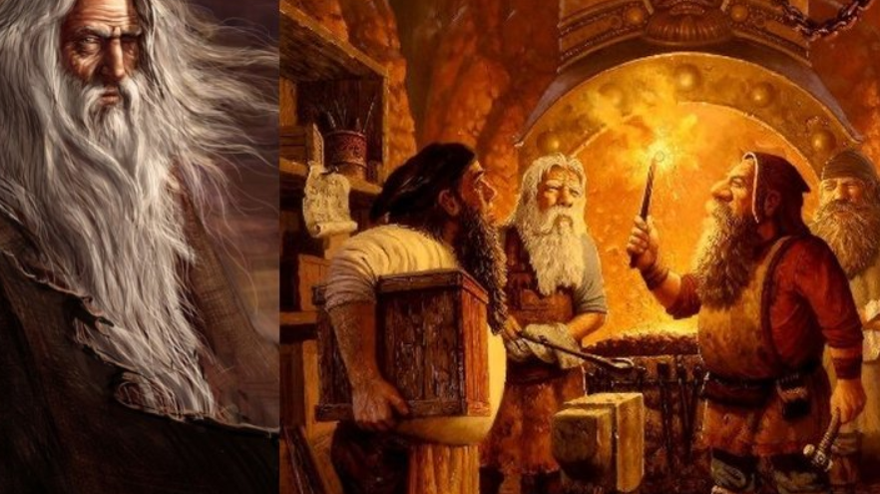
Mythology
This Photo by Unknown Author is licensed under CC BY

Slide 14
The Myth of Pluto the God of Brawn
Once upon a time, there was the kingdom of Olympus was ruled by Zeus and his wife Hera. The kingdom was a beautiful bronze gleaming light in the sky. The ground was a soft textured cloud and the sky was a nice baby blue. It felt like a place where royals were meant to be. The god's thrones where covered in the shiniest of golds and the pearliest of whites. The grounds where filled with golden pedals of flowers. The kingdom was filled with royal blue banners that matched each god respectively and there power. Each god had their own cabin made up of the strongest rock found.
Olympus was a place where all the gods resided each and every one of them controlling a part of it much like a human country. All of their parts payed homage to some type of event they encountered in their lives. Athena had a monument of her encounters with Arcane as well as Medusa. Each face carved in the finest stone in Olympus. Cold to touch and let out dark blue current to hands that where unwelcome cursed by Zues himself. All of Olympus was covered in statues just like them Hercules taking down a lion with his bare hands and the greatest and biggest one of them all Zues throwing lightning bolt directing piercing Coronus through his tough skull.
In the kingdom of Olympus Zeus and Hera where the gods of the sky and marriage. They served as the all mighty king and Queen and the gods where mere loyal soldiers. Until one day, Zues and Hera had a unusual occurrence Hera was pregnant. Most gods where born out of thin air or wildly unordinary birth for example Athena the goddess of wisdom and war was born out of Zues head. Hera named her son Pluto; Pluto grew up in Olympus with everything gifted to him. Accepted one fatal thing the fact that he had not one power unlike every single god on Olympus. Pluto was ashamed of this fact as well as all the other gods on Olympus felt as if wasn't a real god and the only reason he wasn't immediately banished from Olympus was the fact he was Zues's son. After many years of this torment Pluto finally showed some potential as god he showed raw and unattainable strength that even rivaled the power of Zeus
The gods realized this Pluto was sent on numerous missions by Zeus to get affairs in order on Earth. Pluto had never failed one of these missions in his life and began to feel as if he was untouchable. He had never felt this good about himself his whole life and now things where amazing. This sudden change in attitude startled the gods and they began to grow worry of sending him on any missions, so they suspended him from leaving Olympus. As expected, when they broke the news to Pluto he was outraged and let out an abundance of spiteful words towards the gods. As the days went on, to kill the tension all of Olympus got together to have a party.
After everyone on Olympus was notified they all rushed to Golden ball room into the heart of Olympus. The ball room was lit by the rays of the sun and crafted with the best materials the world has to find. When everyone arrived one thing of all stood out, Pluto was nowhere to be seen. Everyone noticed it but never motioned it the whole time. Until, Pluto burst through the 2 grand doors drunk out of his mind spouting out random inaudible sentences. But, one sentence was widely understood, I challenge each and every one of you to a battle at the same time.
Some gods accepted and stepped up, they were tired of his attitude and about to bring his high ego back down to earth. Before any of this could happen Zues stepped in and put the fighting and bickering to an end. Zues expressed his disappointment with his son Pluto, but nothing seemed to get through his thick skull. Zues got tired of Pluto's poor understanding of his mistakes so he decided to send him on a special mission. A mission which was so special it would prove to be too much of a challenge for Pluto immense power. Zues banished him to Earth in what seemed to be a dragons den.
Pluto woke up face down on dirt and gravel in the dragons den. The dragons den was full of humans but not any normal humans. These humans had muscles, they were tall and looked exactly like gods they weren't. When Pluto finally woke up greeted by the godly sight of Zues and about a dozen human men. Zeus had the most disappointed look on his face that Pluto had ever seen. Zeus was both mad and disappointed with his son and that his extreme arrogance resulted in this form of punishment. Took a group of soldiers in the Greek army and gave them Pluto powers.
The humans where under Zues's control in case they tried to escape. Pluto confronted Zues about his plots against his own son. Zeus wanted to hear nothing of his sons pleads for mercy he gave him so much time to work on himself. But, now he pulled the last straw he specifically instructed the humans to train with Pluto and learn his power and when done take his power for themselves and run los with it. The humans in the den walked slowly towards Pluto's body and held him up by his arms and made him pledge to teach them all aspects of his power. Just like that Pluto's years of torture begun.

Slide 15
The Myth of Pluto the God of Brawn cont…
This torment went on for years and years until one day Pluto had enough and was going to make a break for it. Pluto wasn't the type man to run away from his problems but he'd hit rock bottom a long time ago. His plan was sneak past the humans while they slept and run far away it wasn't amazing but just enough to get away. That very same night his plan went into effect, as he crept pass one of the humans they caught him red handed. Pluto had planned for this exact moment he harnessed all of might into every single muscle in his body. Unlike before he wasn't going to be smothered in pain and defeat but overcome them make them suffer for what they did to him.
The humans rushed him but Pluto was prepared he broke there huddle in one swift swing of his arm against the wind. They got back up and came back twice as hard but failed again so they took a different split up and take him one on one which was horrible idea. Pluto hurled a boulder in their direction they ran but were crushed or so he thought only remained after that attack. The remaining 3 stood in stance while Pluto charged up for an onslaught of attacks. This strength was unlike any other they had seen from Pluto had they finally found out his power... BOOM... Pluto had tripled in size and punched all three of them through the dome roof of the den.
His punch had caused tremors splitting the ground in half and earthquakes across the planet. The humans' blood turned rivers red and plants decaying like rotten wood. The damage had been done the world was mere dust and the gods were alerted by the earths stinge of blood. Zeus came down from the heavens to seen what happened when it struck him. He saw his son covered in the blood of the very humans he sent to destroy him. He was furious he rushed to Pluto with full intent of eliminating him but something told him to stop. He saw Pluto laughing hysterically at the death of thousands he caused he was filled with glory he was really better than everyone even his stupid father.
Had he learned nothing from that day in the palace after all those years he still had the same level of arrogance as before. Nothing had changed. Zues's face paled as his son turned to him and punched him across the planet. Zeus had never felt pain that strong ever in his life the first attack that wounded him. At that point Zeus new exactly what had to happen and only one could walk away alive. The sound of thunder boomed across the Earth Pluto body was struck down beneath the planet as he lived there lifeless. Zeus wept, his only son was consumed by his arrogance and rage. He never wanted him to go down this path but it was done now the Earth was mere dust and his son was gone.
As the years after Pluto's death went by the gods slowly and surely rebuilt the Earth piece by piece. In memory of his son Zeus gave humans some of the same qualities his son had good and bad. He gave them strength and arrogance to some it will hinder and to some it will bring success.

Slide 16
Athena and Her Help…
One day Athena was practicing on her shape shifting. The air was thin in the village called Kigem and there were flowers and trees bursting out of the ground. The houses were small and had vines going all around the house. Dark green leaves scattered on the ground. As the sun came out the clouds were moving back you could see the light blue sky.
A little breeze of wind flowed through her dark brown hair. The pond was clear a blue and the rocks sunk to the bottom without a sound. The village was small and very packed together. The air became a little windy. The vines on the houses swung back and forth.
While Athena was practicing on her shape shifting he overheard a couple arguing. Their names are Anna and Jim. Almost everyone in town knew the because Jim is the mayor. He would make Anna pass out the flyers and he would make her feel like she was nothing.
The next day Athena's wisdom kicks in and she goes to shape shifts into an old women. She goes into a candy store and she bumps into Anna's and Jim's neighbor. Her name is Mabel and she knows them very well. They have been neighbors for 7 years.
When Athena goes into the candy store Mable and Athena start talking. Athena asked," Why do the men think they can control the women?" Mable said," Over 100s years now men think they could control women. My neighbor her husband takes control of her anything he say do she does it. I really don't know why though."
Athena answered ok and can you come by my tomorrow by 12:00pm and tell your friend to come by to. Before Mable left the candy shop Athena asked if she could help out with a favor. They put a note in every ones mailbox. The note had Athena's address on it and the time to come by. The next day arrives and before all the women arrives Athena wanted to talk to Jim. She goes to Jim's office and he let her in. He said," Who are you and what do you want." Athena said," My name is Athena and I want to talk about your wife Anna." Jim said," Yeah what about her?" Athena tells him about how he treat her like she is nothing and doesn't respect her. Jim starts to deny all of what Athena is saying so she just leaves.
When Athena left and got back home 12:00 came running by. She shape shift back to the old women. Everyone starts to show up Athena opened up her door she start talking to the women. She tells them to stop letting these men run over you so when you go back home I want you to stand up for yourselves. Everyone goes home and start to stand up for themselves.
That day was a special day it helped women around the world to learn to take action and gain respect. For a long time men would just put women down. Then men would tell them they are just not good enough. Women learned it's ok to stand up for themselves. Without Athena women wouldn't have independence.
Athena help motivate and push women to become who they are today. So many people gained respect for women. It also pushes women's self-esteem. They are so many jobs for women now because back then there weren't a lot of jobs for them. Today in our society women get a lot more respect and honor.

